Slide 1
3rd Generation Intel®
Core™ vPro™ Processor
The Business Case
[Presenter:]
[Title:]
[Date:]

Slide 2
Presentation Notes
Internal use only – Please remove before forwarding or presenting
Usage guidelines:
  This presentation is designed to help you make a compelling business case for incorporating 3rd Generation Intel® Core™ vPro™ processors as part of the IT strategy within your organization. The presentation covers the comprehensive business benefits of the 3rd Generation Intel Core vPro processor, including embedded security, built-in client management, energy efficiency, and return on investment. Intel vPro technology is also available in innovative form factors, which helps minimize the impact of IT consumerization by letting users work on the devices they want while IT maintains full control of corporate security.
  The slides are designed to drop into a larger presentation or stand alone. Use the slides most appropriate for your situation.
  Refer to the two slides at the end of this presentation for legal disclaimers.
About this presentation:
  The 3rd Generation Intel Core vPro processor is designed to help you meet the challenges of today’s business environment, from advanced threats and rootkit attacks to the onset of IT consumerization, cloud computing, and desktop virtualization.
  Adding the 3rd Generation Intel Core vPro processor as part of your IT strategy will help you address top IT security needs, including threat management, identity and access, data protection, and monitoring and remediation.
  In addition to providing built-in security features, the 3rd Generation Intel Core vPro processor delivers the intelligent performance you expect from Intel, as well as high-quality HD audio and video support, energy efficiency, and superior responsiveness.
Audience: IT executives
Region: Worldwide

Slide 3
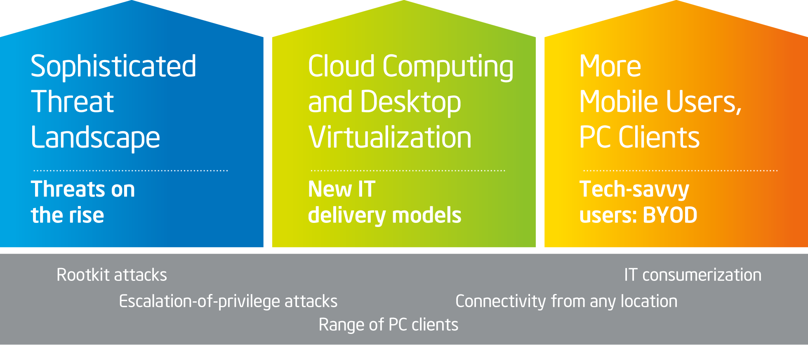
New IT Security Landscape
Notes:
Key Points:
1) Current business environment is taking IT security to a new level:
Today’s threat landscape is far more sophisticated (growing malware, rootkit attacks, escalation-of-privilege attacks).
Onset of new IT delivery models brings new challenges (desktop
virtualization, cloud).
IT consumerization means new PC devices—and less IT control—combined with users who have high expectations for performance and connectivity.
2) Although software-based solutions are the foundation of most PC security management solutions, this threat landscape requires more.
Notes:
Today’s business environment is changing fast—and it means drastic changes for IT security. The threat landscape is like nothing we’ve seen before. Sophisticated threats now range from rootkit attacks and escalation-of-privilege attacks to international security breaches and everything in between. The need to institute better protection for confidential business data is greater than ever.
IT also continues to adapt delivery models for cloud computing and desktop virtualization, which bring a new set of security risks.
Finally, the growth of IT consumerization is reducing IT’s ability to control security. Users are working on the PC devices of their choosing and accessing a range of cloud services, regardless of whether either is IT approved. Making matters worse, these users have high expectations for performance, and they want network connectivity from any location.
Although software-based solutions are the foundation of most PC security management solutions, this business landscape requires more. Our IT security strategy currently includes [describe your recent and ongoing security measures].

Slide 4
Built for Business. Engineered for Security.
3rd Generation Intel® Core™ vPro™ Processor
Specifically designed for business
Embedded security features
Built-in client management
Energy-efficient performance
Innovative form factors
4
Notes:
Key Points:
The 3rd Generation Intel® Core™ vPro™ processor delivers the embedded security you need to stay ahead—without compromising on performance.
The built-in security technology delivers an added layer of protection to software-based solutions.
Notes:
With the embedded security of the 3rd Generation Intel Core vPro processor, organizations can gain an added layer of protection for clients and business data. And it’s all delivered without any compromise on performance: Intel vPro technology provides the built-in security you need with the intelligent performance you expect from Intel.
This technology really is designed for business:
It’s designed to provide an added layer of protection below the operating system; the hardware-based security works in addition to software-based solutions.
It comes with integrated tools to help simplify client management, saving both IT time and resources.
It’s highly responsive with a long battery life for better energy efficiency.
The technology is available in a range of innovative designs to meet the needs of the most discriminating users. It also comes with high-quality, high-definition (HD) video graphics.

Slide 5
Addressing Top IT Security Needs
Threat Management
Data Protection
Prevents viruses and malware from entering your network with a protected launch environment
Guards against escalation-of-privilege attacks and keeps viruses from taking hold in your system
Accelerates data encryption up to four times faster¹ without interfering with user productivity
Generates higher-quality random numbers in encryption for safer online transactions
Uses anti-theft technology to automatically disable itself if lost or stolen
Identity and Access
Monitoring and Remediation
Data Protection
Protects access points with hardware-based storage of tokens or certificates
Prevents screen-scraping attacks with a secure PIN pad that verifies human presence at the PC
Remotely access and control any PC through all states, including reboot
Proactively push security updates, and diagnose and repair after a breach has occurred
1 Software and workloads used in performance tests may have been optimized for performance only on Intel microprocessors. Performance tests such as SYSmark* and MobileMark*
are measured using specific computer systems, components, software, operations, and functions. Any change to any of those factors may cause the results to vary. You should consult other information and performance tests to assist you in fully evaluating your contemplated purchases, including the performance of that product when combined with other products.
5
Notes:
Key Points:
There are four pillars that define IT security for most enterprise operations: threat management, identity and access, data protection, and monitoring and remediation.
The 3rd Generation Intel® Core™ vPro™ processor works across each of the four pillars to give you a built-in layer of protection.
Notes:
Intel vPro technology works across the four pillars that define IT security for most enterprise operations. These pillars include:
Threat management
Identity and access
Data protection
And monitoring and remediation, which really extend across the other pillars
With rootkit attacks and other malware on the rise, threat management is critical. This is about preventing viruses and malware, but also about keeping them from digging in deep where they can do the most damage. Intel vPro technologies work together to establish a hardware-based root of trust and actively monitor key client system components, and work against escalation-of-privilege attacks by providing automatic “blanket” protection.
Identity and access is all about securing authentication and protecting passwords against screen-scraping attacks. Intel vPro technology works with leading authentication solutions to support hardware-based storage of tokens or certificates. This reduces costs and protects against tampering because the credential is stored inside the platform.
Next, data protection is perhaps the most important. Intel vPro technology encrypts data up to four times faster, without impacting performance, and it offers stronger key encryption to protect online transactions. It also protects against theft: Intel Anti-Theft Technology has the ability to automatically disable a PC that has been lost or stolen—sometimes before the user is even aware. IT can also remotely access the stolen PC to disable it.
Finally, monitoring and remediation give IT full control, regardless of the user’s location or situation. Intel vPro technology delivers powerful remote support capabilities so that IT can manage, control, diagnose, and repair PCs—in any operational state, including powered off or in need of a reboot. This also means that IT can work proactively to push security updates at any time, in addition to remote PC polling, inventory, or compliance updates.

Slide 6
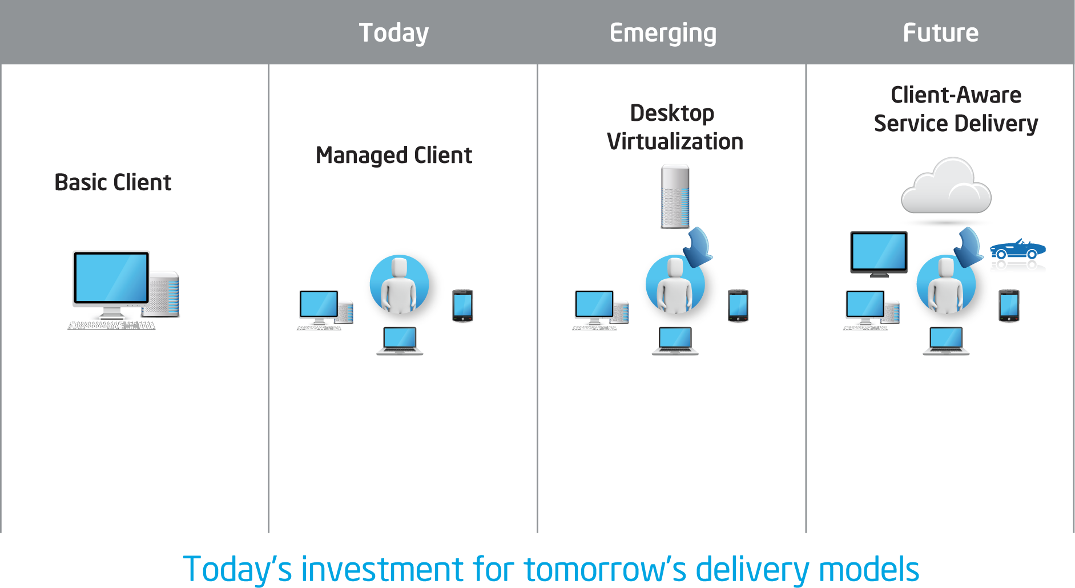

Evolving Compute Models
Intel® vPro™ Technology for the Future
Notes:
This is a build slide.
Key Points:
Intel® Core™ vPro™ technology is designed to meet your business needs now and in the future.
Notes:
An investment in Intel vPro technology today is designed to prepare businesses for future compute models. It’s a fit for today’s basic managed client systems, and it adapts to meet the emerging compute models, such as desktop virtualization and cloud services.
As you can see in this slide, the security technologies such as Intel Virtualization Technology (Intel VT) and Intel Active Management Technology (Intel AMT) extend to desktop virtualization and cloud models, with the ability to evolve as the threat landscape continues to change. So as the business grows, the technology adapts to meet changing business needs.

Slide 7
Energy-Efficient Performance
Less Energy Consumption
Improved performance per watt
Remote shutdown after hours
Powerful battery life
Saves Energy
and
Increases Employee Productivity
Superior Integrated Graphics
Optimized for content creation and consumption
High-definition (HD) video
Quick, Easy Access
Powers on in less time
Users get immediate access to data, network
Notes:
Key Points:
The 3rd Generation Intel® Core™ vPro™ processor improves performance, but with power efficiency.
Notes:
The 3rd Generation Intel Core vPro processor is designed to increase energy efficiency.
It’s highly responsive, which means it can power on in less time, but use less power
when it’s not in use. It offers better performance per watt and gives IT the ability to automatically power down PCs remotely, after work hours. A powerful extended battery
life offers greater convenience, and it means that mobile employees can stay productive longer.
The processor is designed for heavy content consumption and has integrated, high-quality graphics capabilities, so there’s no extra draw on power.
Users can open up a laptop, get immediate access to the network, and get to the data they need. This results in greater employee productivity because users can get to the information they need quickly—without having to leave their computers in a powered-on state.

Slide 8
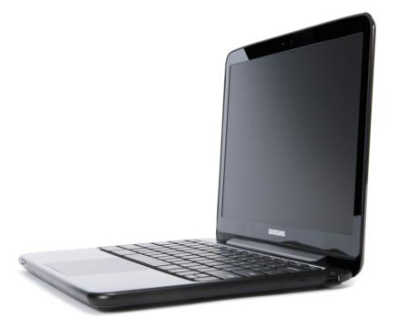
Innovative Designs, Full Security
Users Get the Devices They Want with
No Compromise to Corporate Security
All-in-One PCs
Ideal for offices with limited space
High performance, power efficiency
Touch screen, multiuser capability
Thin and Light Laptops
Ideal for users on the go
Easily portable yet sturdy
Notes:
Key Points:
The 3rd Generation Intel® Core™ vPro™ processor delivers performance in compelling form factors that are sure to meet the needs of your most discerning users—without sacrificing corporate security.
Notes:
We talked about IT consumerization—or BYOD—earlier, and it’s a reality in today’s business world. With the built-in security and performance features of the 3rd Generation Intel Core vPro processor now available in a range of innovative designs, users can work on the PC devices they want without any sacrifices to corporate security or control.
The all-in-one design is a perfect fit for office environments that have limited space. This compact, elegant design has all the power needed to create, manage, and consume content. Users can get up and running quickly with intuitive tools, such as a touch screen that can handle multiple-user interaction and a stylus for capturing notes and signatures. The simplified design also means less IT maintenance.
For mobile users, the thin and light laptop designs are ideal. These sleek designs deliver all the power users need in a highly portable, lightweight form factor that is easy to stow. It can run multiple tasks simultaneously, with an extended battery life that is perfect for employees on the go. Essentially, the thin and light laptop delivers all the convenience of a portable PC with the power to complete any task.

Slide 9
Strong Return on Investment
Improve IT Efficiency, Boost Security, and Reduce Energy Consumption
Remote Remediation
Improved Patching
Energy Savings
Resolve support issues quickly and reduce IT
travel costs
Reboot and reimage
PCs remotely, without
user intervention
Simplify asset management
Push patches to wired and wireless PCs at any time
Increase patching speed
and frequency to help reduce costs
Proactively manage
security updates
Reduce consumption
with remote power
on/off capabilities
Improve and enforce support for power management policies
Reduce carbon emissions
Notes:
This is a build slide.
Key Points:
The 3rd Generation Intel® Core™ vPro™ processor delivers key benefits to help you realize a greater return on investment.
Notes:
With the capabilities of the 3rd Generation Intel Core vPro processor, organizations are able to realize a significant return on investment.
<Click> The first is remote support and remediation. Remote IT support is a powerful benefit—especially since desk-side support visits are no longer always a feasible option. It drastically improves IT productivity because it eliminates time restrictions, as well as the need for user intervention. It also simplifies the time-intensive task of inventory management.
<Click> Next is improved patching capabilities. With the 3rd Generation Intel Core vPro processor, IT can push patches quickly and easily to any PC at any time. It’s also a way to proactively manage security by pushing security patches to users before a breach occurs.
<Click> Finally, we have energy savings. We talked about some of this in the previous slide. When you can remotely power on and power off PCs, you can better control energy usage. It’s also a way to enforce company energy policies by giving IT the ability to better control users’ power consumption.
That’s an overview of some of the key benefits that help increase your return on investment. Next, let’s take a closer look at a study done on the business value of Intel vPro technology.

Slide 10
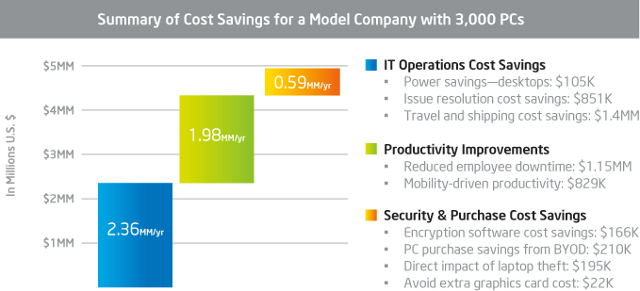
Business Value of Upgrading
Wipro Consulting study estimates $5M annual savings for model company with 1,700 desktops and 1,300 laptops by upgrading to Intel® Core™ vPro™ processors¹
1 Wipro Consulting. “Measuring the Value of Intel Core vPro Processor in the Enterprise” (July 2011).
Notes:
Key Points:
The Intel® vPro™ technology delivers financial savings across IT management—from help-desk support to data protection and configuration.
Notes:
This slide captures some key findings from a study done on the business value of Intel vPro technology. In 2011, Wipro Consulting took a look at the challenges and costs of managing end-user computing devices and how Intel vPro technology could contribute to productivity and help reduce those costs. The study included 152 IT leaders from the United States, the UK, and Germany.
The study results revealed that significant benefits can be achieved. Remote support capabilities improve IT efficiencies, boost cost savings, and help minimize downtime. IT security capabilities, such as Intel Anti-Theft Technology, had a direct savings impact on data protection, including reducing the legal and regulatory costs of a security compromise. There were also estimated savings around energy efficiency, virtualization, and rich media—the list goes on.
Using an example of a model company with 1,700 desktops and 1,300 laptops, Wipro Consulting estimated that the company could realize nearly $5 million in annual cost savings by upgrading its client systems to ones based on Intel Core vPro technology.
As you can see in this slide, IT operations gains the biggest estimated savings, at over
$2 million. Next is productivity savings—estimated at nearly $2 million—from reduced downtime and increased productivity for mobile users. And then there are security and cost savings from encryption, BYOD, and so on.
If you want more information on this, I’d encourage you to read the full study. It’s called “Measuring the Value of Intel® Core™ vPro™ Processor in the Enterprise,” done by Wipro Consulting.

Slide 12
Legal Disclaimers
Intel may make changes to specifications and product descriptions at any time, without notice.
All products, dates, and figures specified are preliminary, based on current expectations, and are subject to change without notice.
Software and workloads used in performance tests may have been optimized for performance only on Intel microprocessors. Performance tests such as SYSmark* and MobileMark* are measured using specific computer systems, components, software, operations, and functions. Any change to any of those factors may cause the results to vary. You should consult other information and performance tests to assist you in fully evaluating your contemplated purchases, including the performance of that product when combined with other products. For more information, go to intel.com/performance.
Intel® processors, chipsets, and desktop boards may contain design defects or errors known as errata, which may cause the product to deviate from published specifications. Current characterized errata are available on request.
Any code names featured are used internally within Intel to identify products that are in development and not yet publicly announced for release. Customers, licensees, and other third parties are not authorized by Intel to use code names in advertising, promotion, or marketing of any product or services, and any such use of Intel's internal code names is at the sole risk of the user.
Intel product plans in this presentation do not constitute Intel plan-of-record product roadmaps. Please contact your Intel representative to obtain Intel’s current plan-of-record product roadmaps.
Intel vPro™ technology is sophisticated and requires setup and configuration. Availability of features and results will depend upon the setup and configuration of your hardware, software, and IT environment. To learn more, visit intel.com/technology/vpro/.
No computer system can provide absolute security under all conditions. Built-in security features may require third-party software, hardware, or services and an Internet connection. Results may vary depending upon configuration. Consult your PC manufacturer for more details.
No computer system can provide absolute security under all conditions. Intel Trusted Execution Technology (Intel TXT) requires a computer with Intel Virtualization Technology, an Intel TXT–enabled processor, a chipset, a BIOS, Authenticated Code Modules, and an Intel TXT–compatible measured launched environment (MLE). Intel TXT also requires the system to contain a TPM v1.s. For more information, visit intel.com/technology/security.
Intel Virtualization Technology requires a computer system with an enabled Intel processor, a BIOS, and virtual machine monitor (VMM). Functionality, performance, or other benefits will vary depending on hardware and software configurations. Software applications may not be compatible with all operating systems. Consult your PC manufacturer. For more information, visit intel.com/go/virtualization.
No system can provide absolute security under all conditions. Intel Anti-Theft Technology requires an enabled chipset, a BIOS, firmware, software, and a subscription with a capable service provider. Consult your system manufacturer and service provider for availability and functionality. Intel assumes no liability for lost or stolen data and/or systems or any other damages resulting thereof. For more information, visit intel.com/go/anti-theft.

Slide 13
Legal Disclaimers (continued)
Security features enabled by Intel Active Management Technology (AMT) require an enabled chipset, network hardware and software, and a corporate network connection. Intel AMT may not be available or certain capabilities may be limited over a host OS-based VPN or when connecting wirelessly, on battery power, sleeping, hibernating, or powered off. Setup requires configuration and may require scripting with the management console or further integration into existing security frameworks, and modifications or implementation of new business processes. For more information, visit intel.com/technology/manage/iamt.
Material in this presentation is intended as product positioning and not approved end-user messaging.
This document contains information on products in the design phase of development.
This document is for informational purposes only. THIS DOCUMENT IS PROVIDED “AS IS” WITH NO WARRANTIES WHATSOEVER, INCLUDING ANY WARRANTY OF MERCHANTABILITY, NONINFRINGEMENT, FITNESS FOR ANY PARTICULAR PURPOSE, OR ANY WARRANTY OTHERWISE ARISING OUT OF ANY PROPOSAL, SPECIFICATION, OR SAMPLE. Intel disclaims all liability, including liability for infringement of any property rights, relating to use of this information. No license, express or implied, by estoppel or otherwise, to any intellectual property rights is granted herein.
Copyright © 2012, Intel Corporation. All rights reserved. Core Inside, Intel, the Intel logo, Intel Core, Intel Sponsors of Tomorrow., the Intel Sponsors of Tomorrow. logo, Intel vPro, and vPro Inside are trademarks of Intel Corporation in the U.S. and other countries.
*Other names and brands may be claimed as the property of others.

